Slide 1
Final Project Presentation
Derek Chang, Kaan Demirbas, Viet Tran

Slide 2
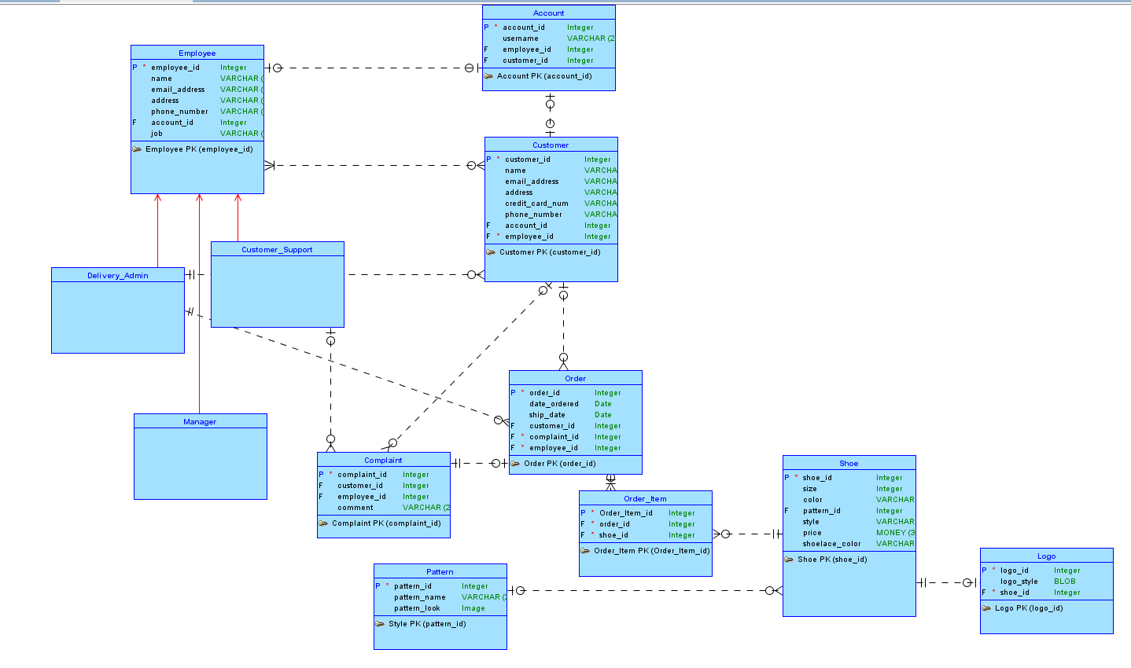
Conceptual Model

Slide 3
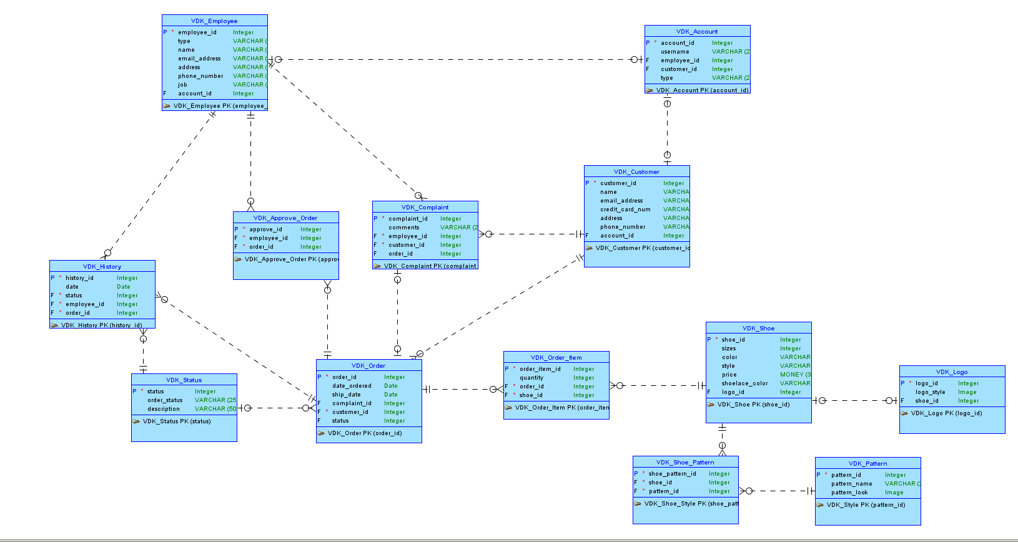
Logical Model

Slide 4
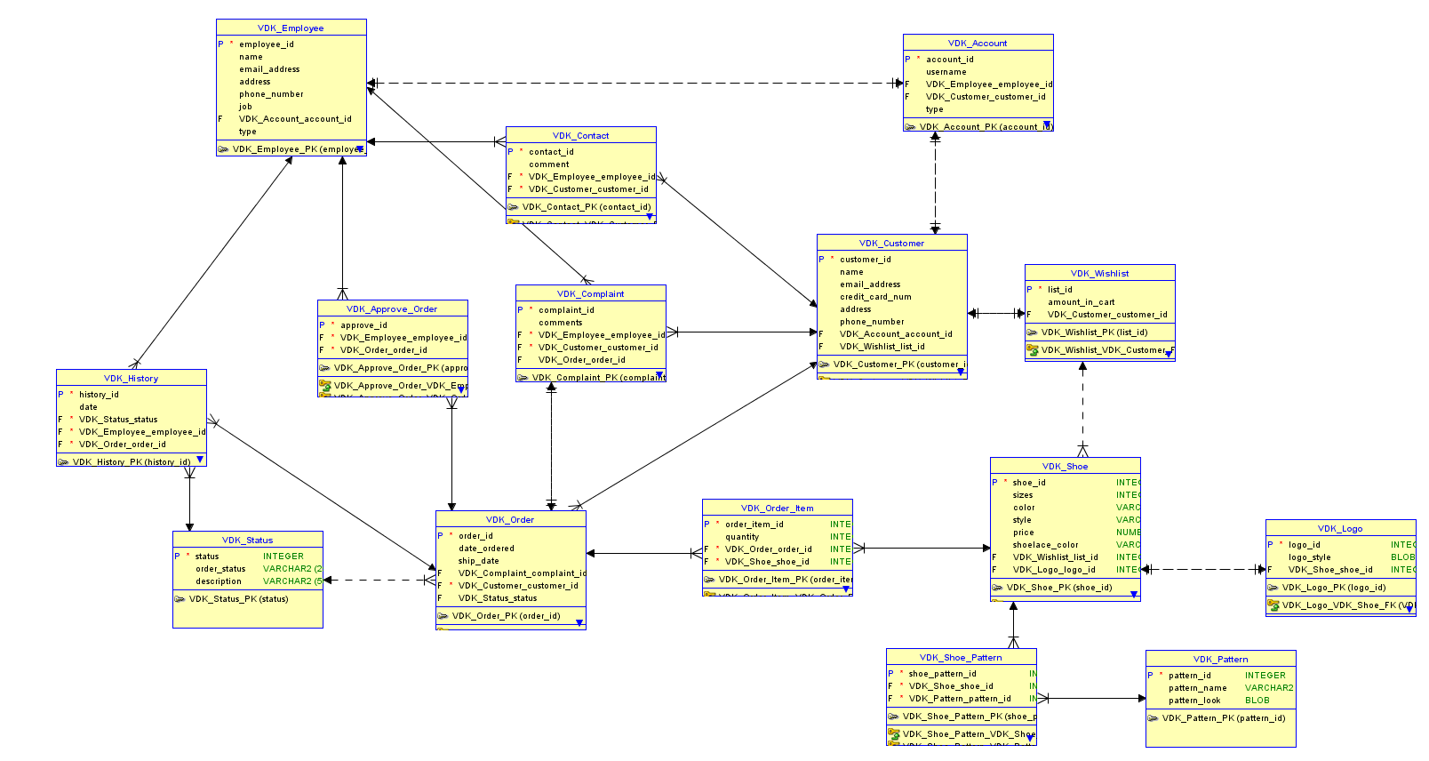
Relational Model

Slide 5
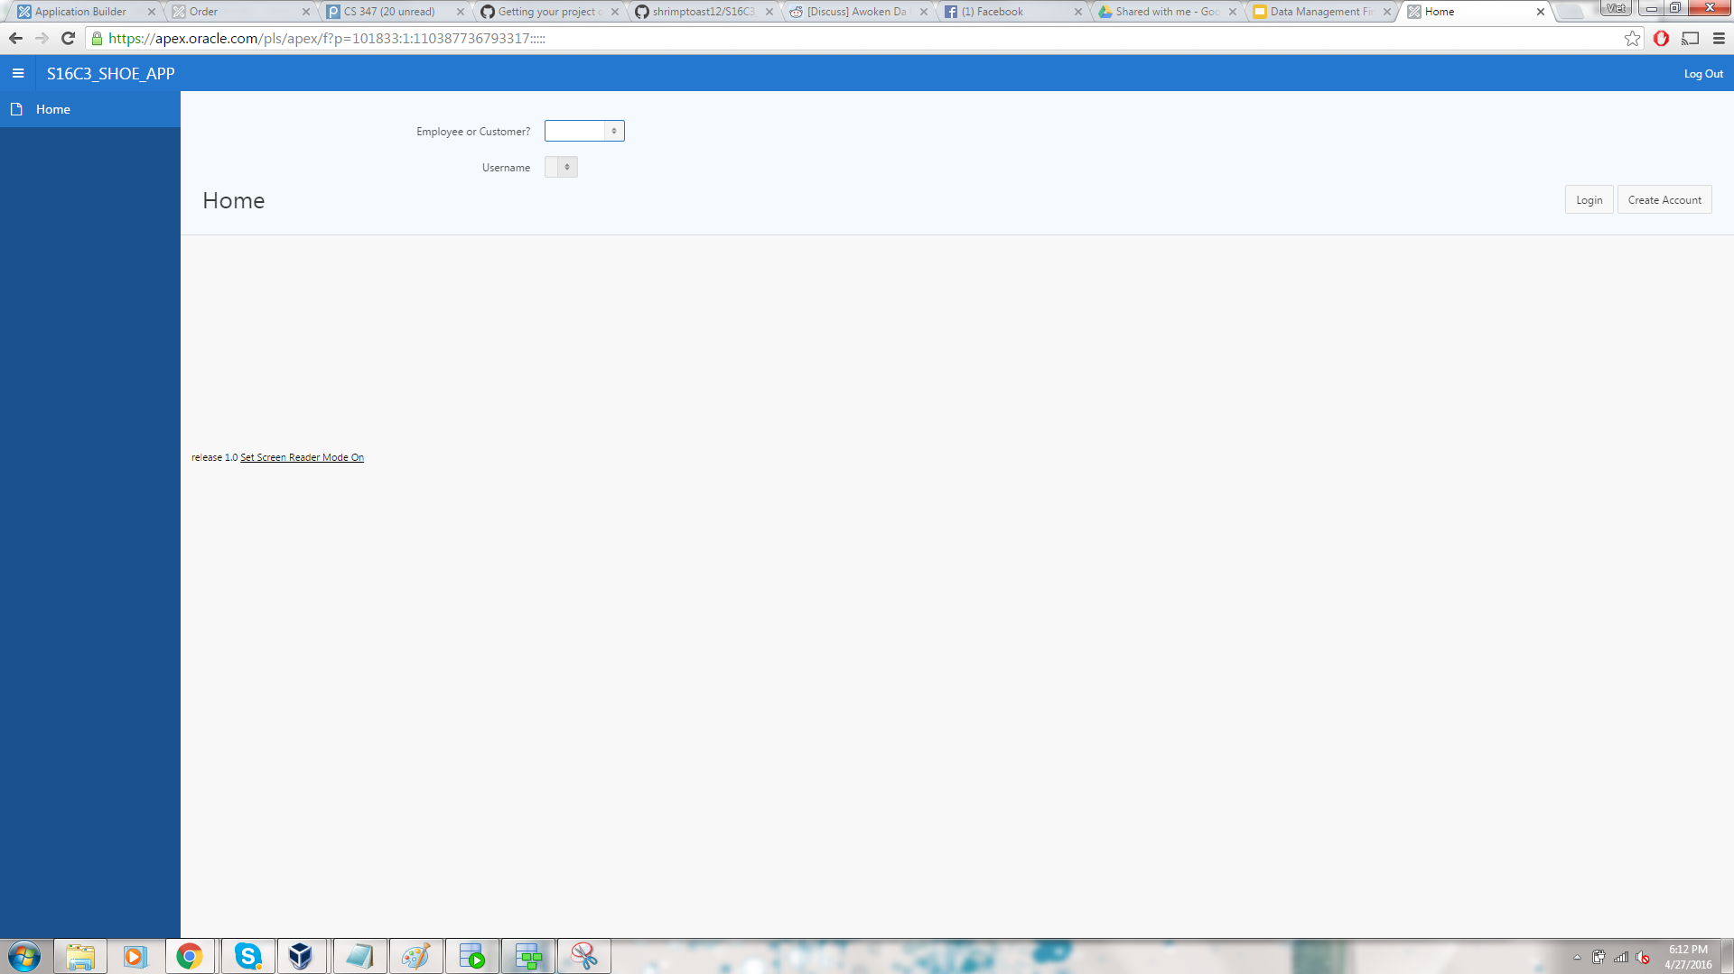
Login Page

Slide 6
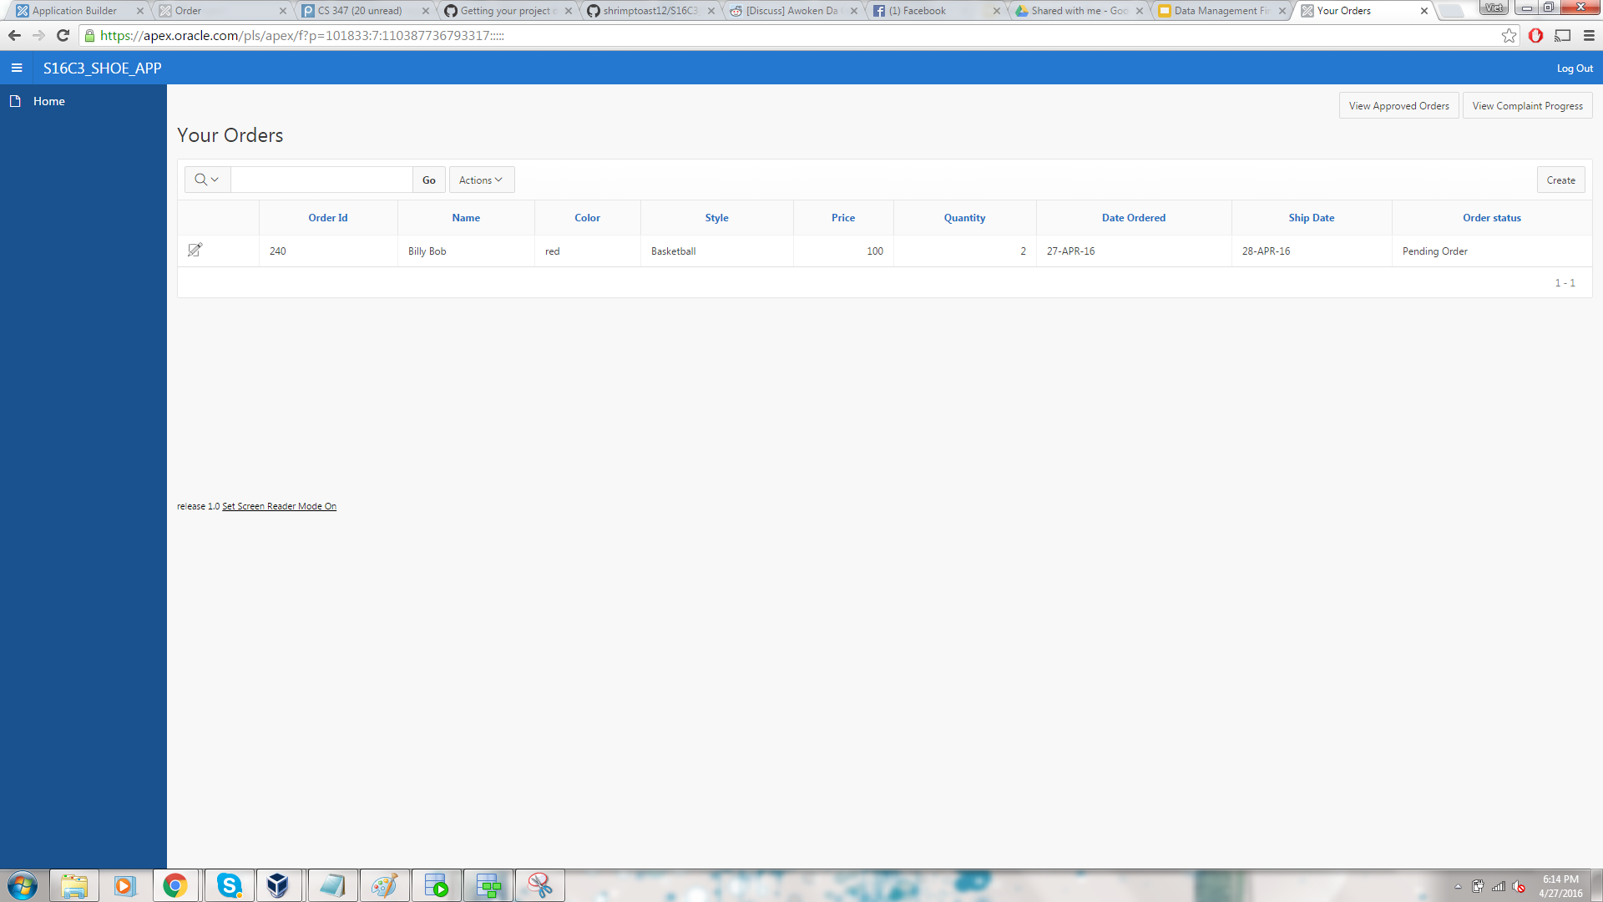
Customer Interface

Slide 7
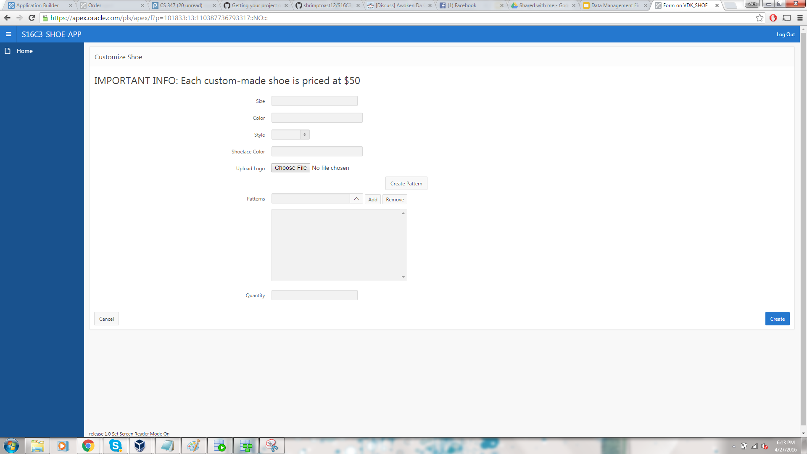
Creating a Shoe Order

Slide 8
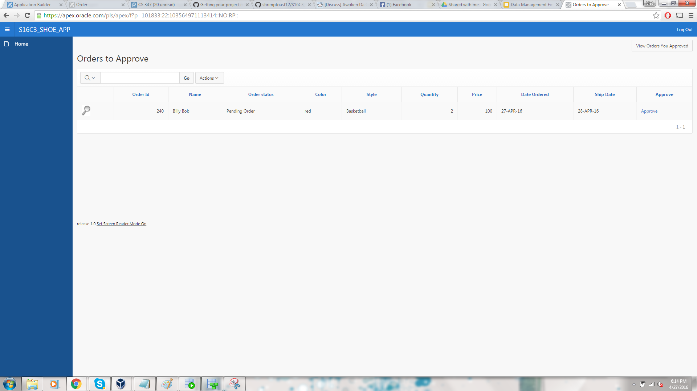
Delivery Admin Interface of Approving orders

Slide 9
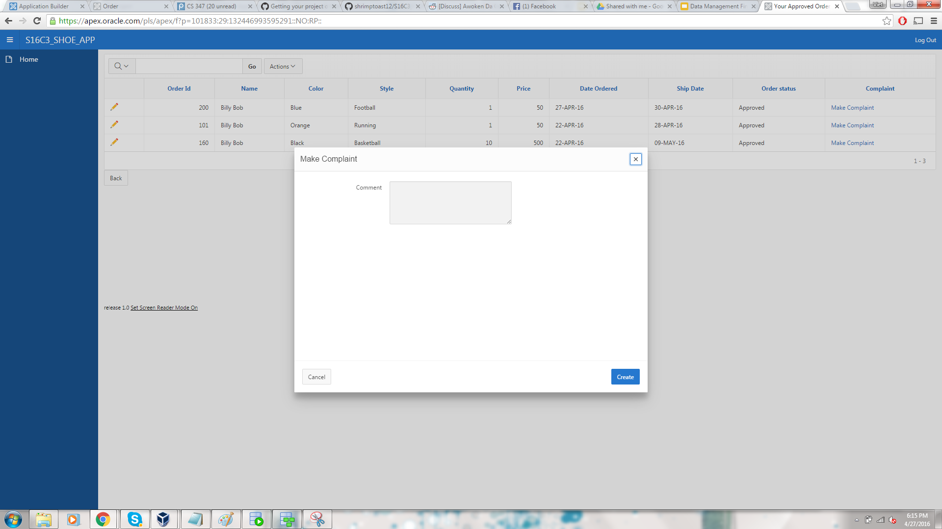
Creating a Complaint

Slide 10
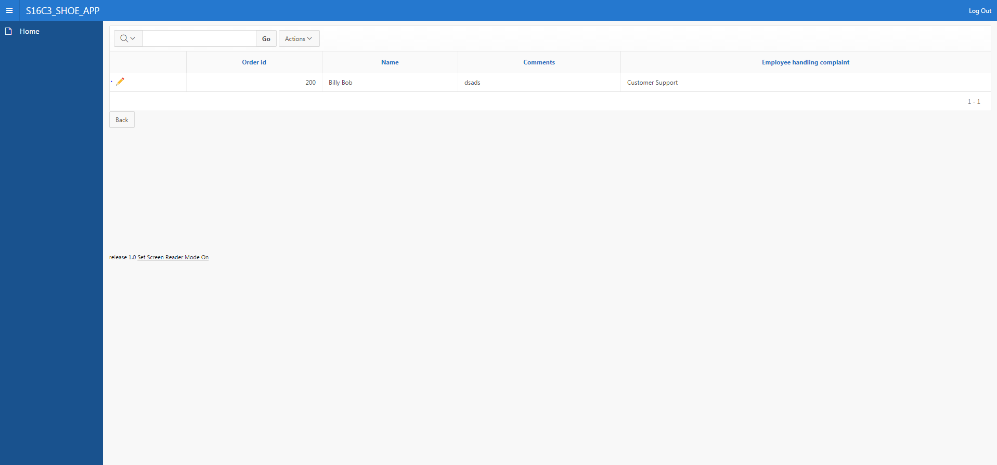
Checking Complaints

Slide 11
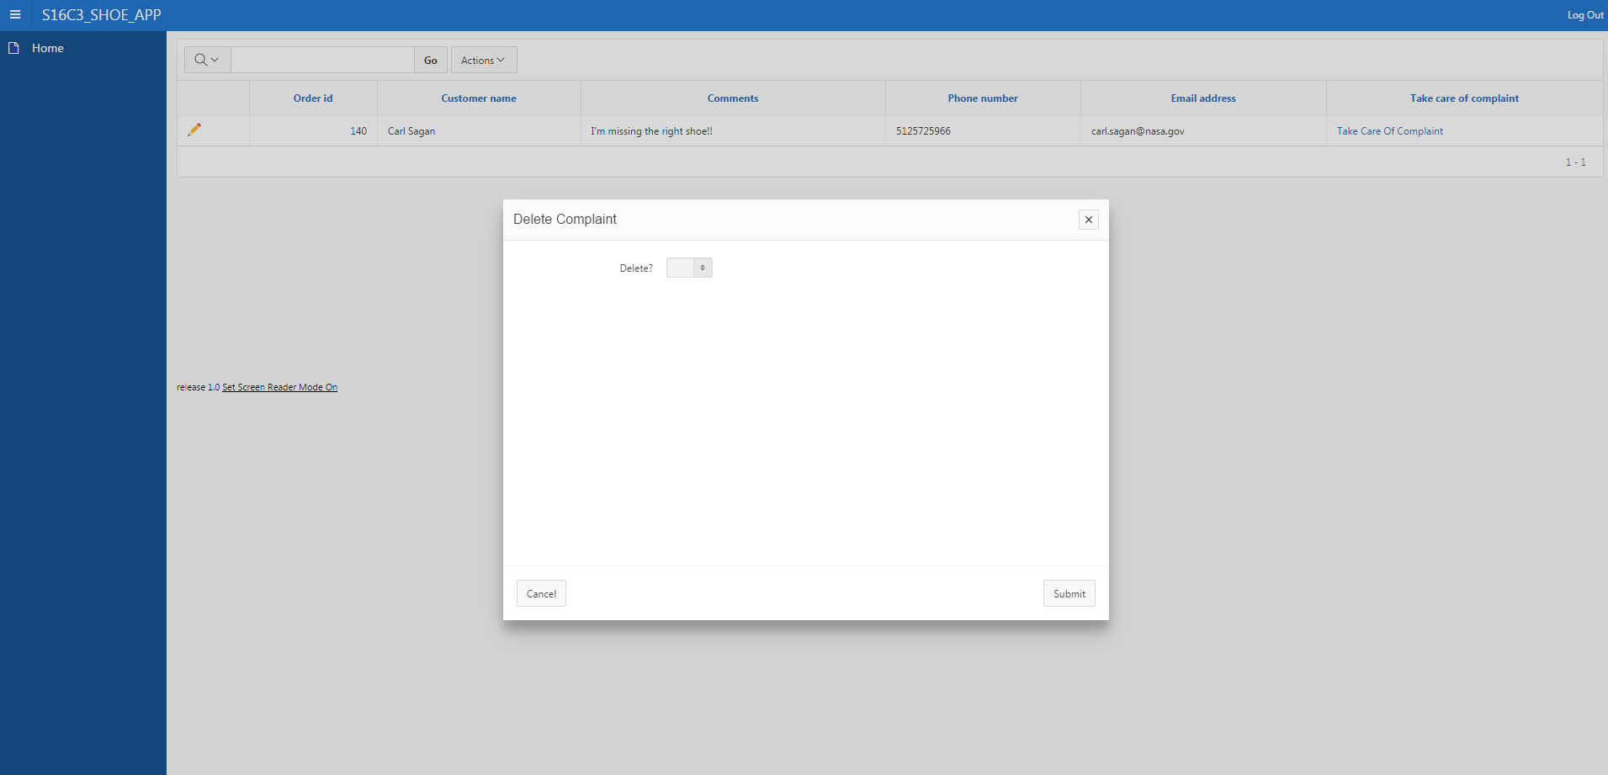
Manager Looking Over Complaint

Slide 12
Github Url
https://github.com/shrimptoast12/S16C3_ShoeApp.git

Slide 13
Part 2

Slide 14
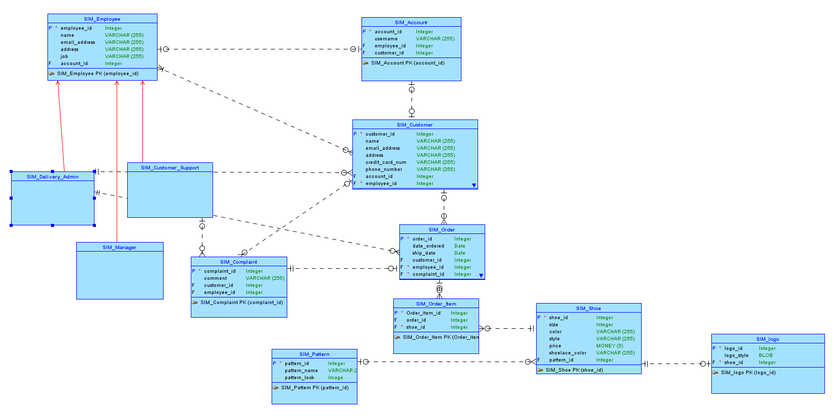
Conceptual Model

Slide 15
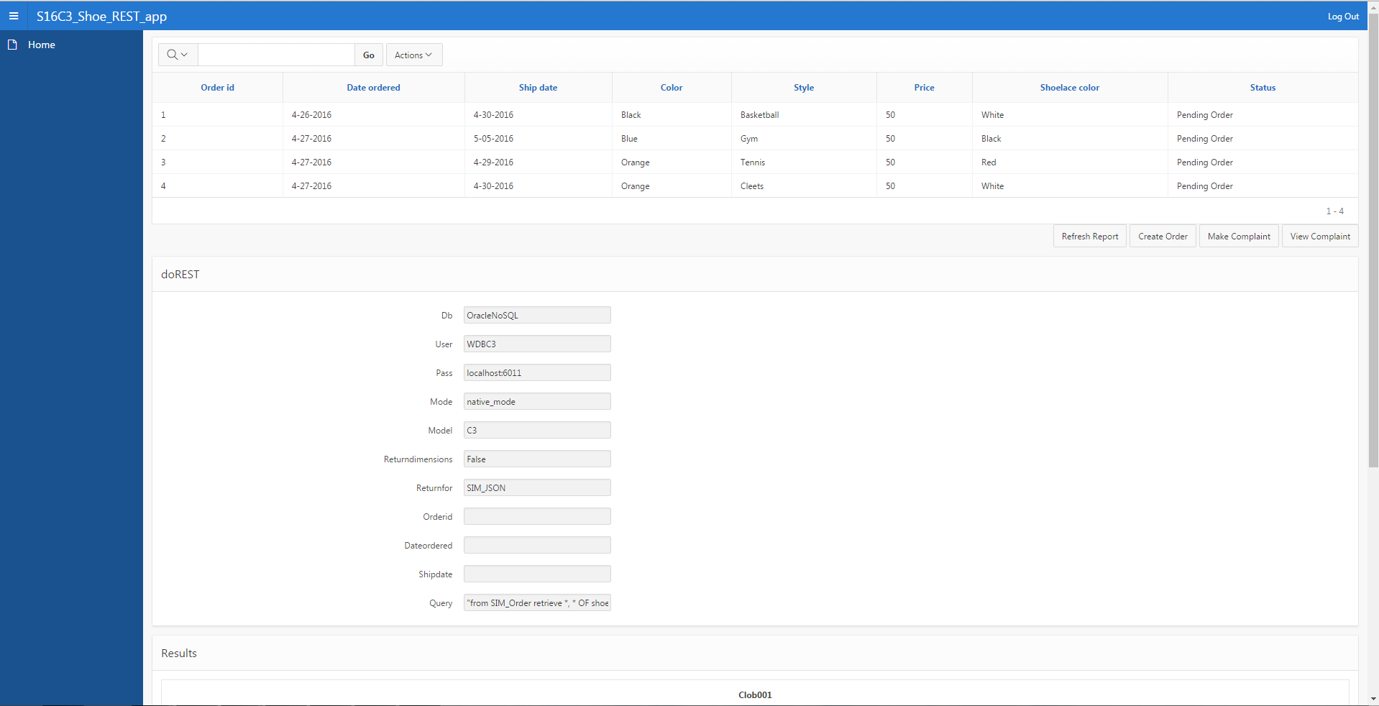
Customer Interface

Slide 16
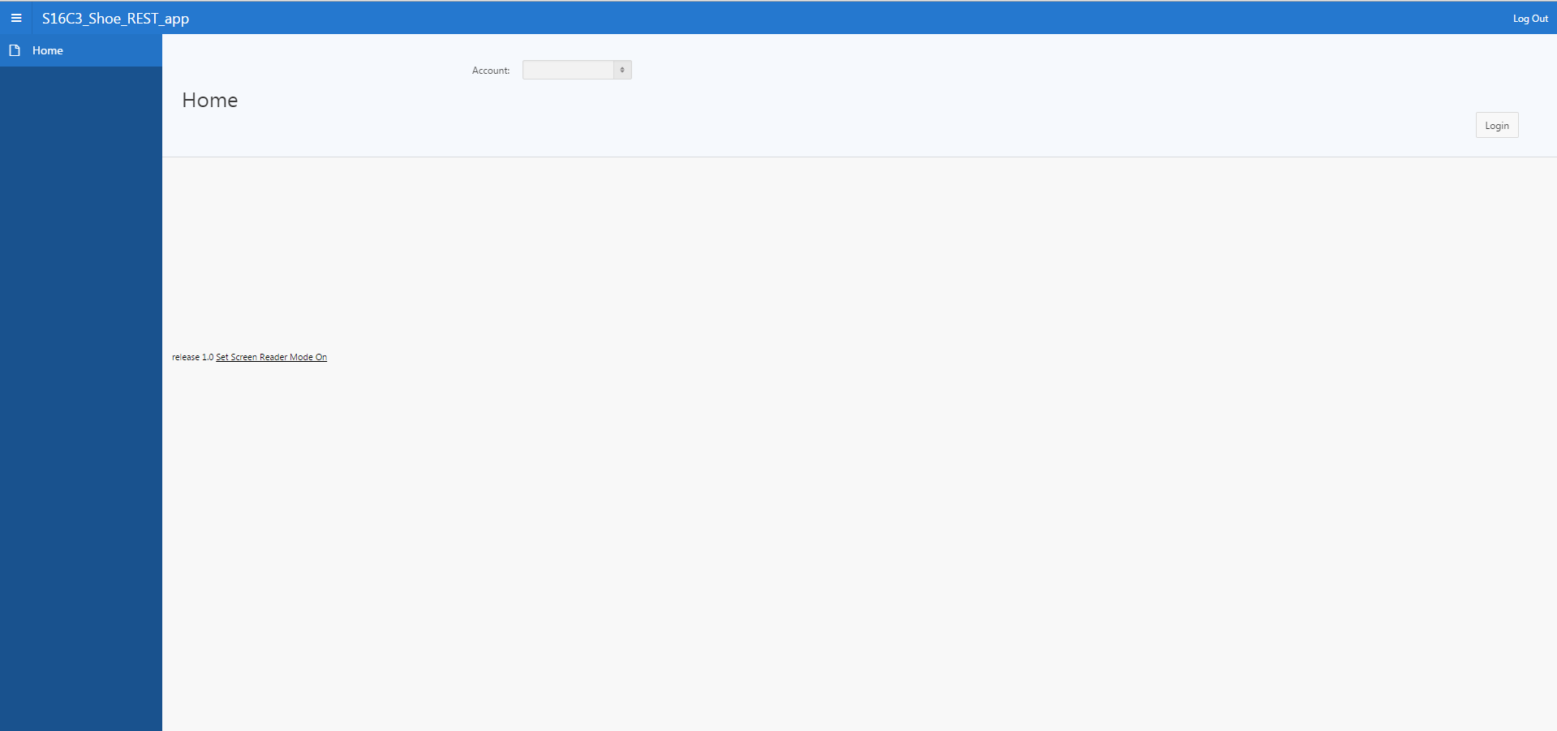
Login Page

Slide 17
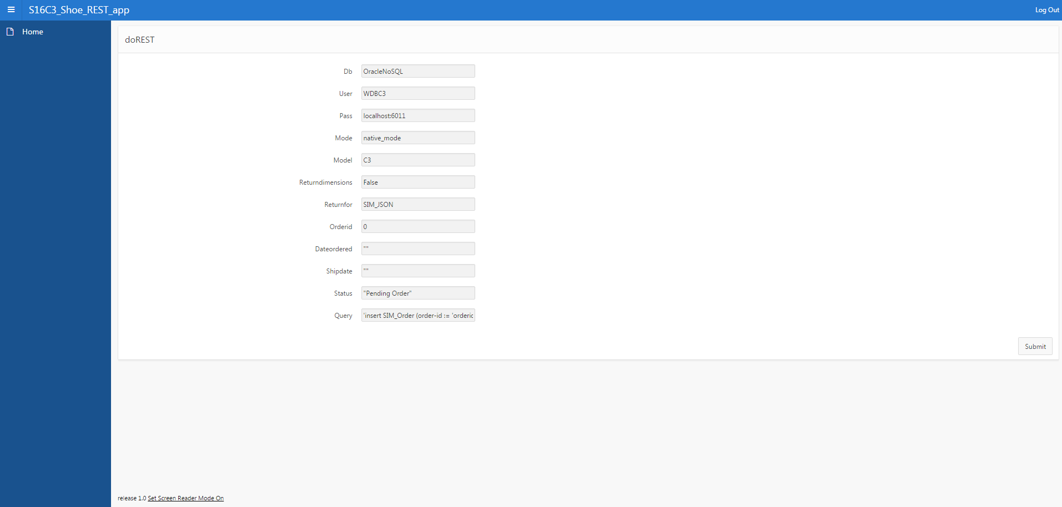
Shoe Order Process

Slide 18
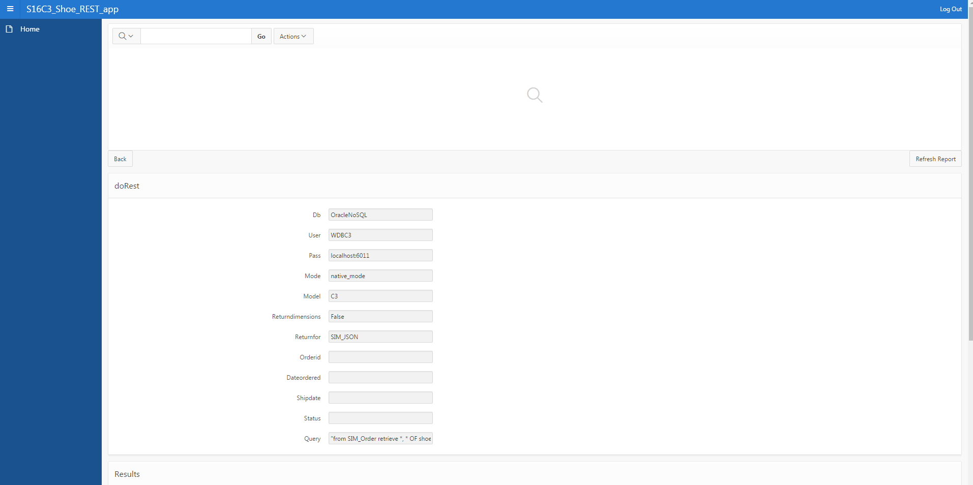
Delivery Admin Interface

Slide 19
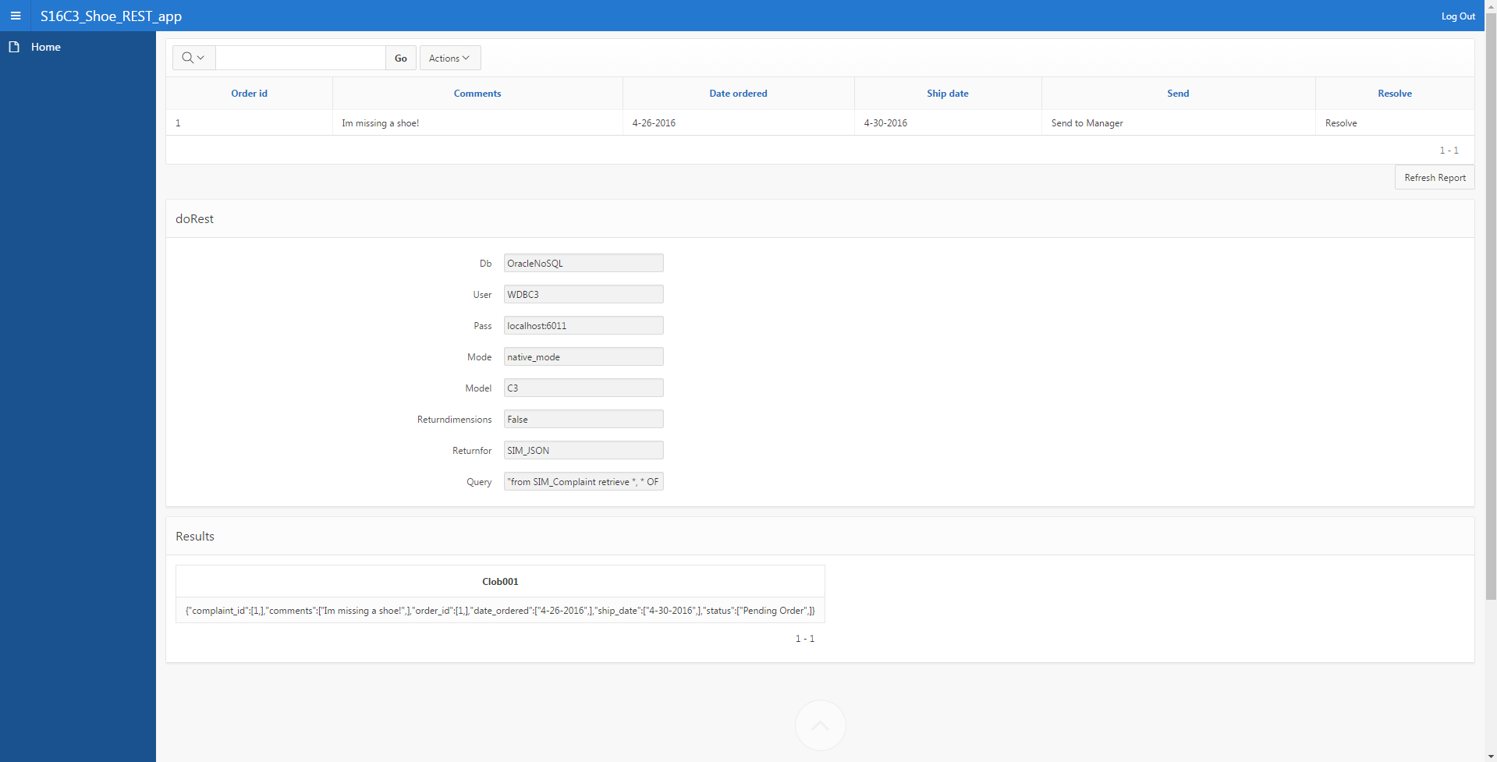
Customer Support Interface

Slide 20
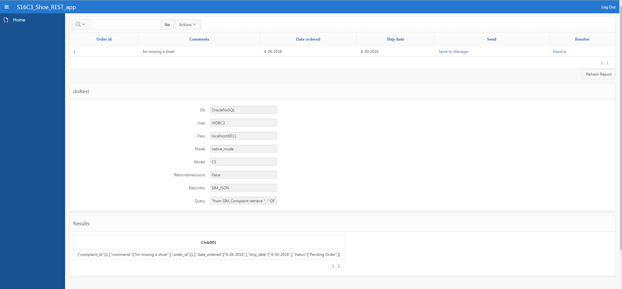
Complaint Handling

Slide 21

Manager Interface

Slide 22
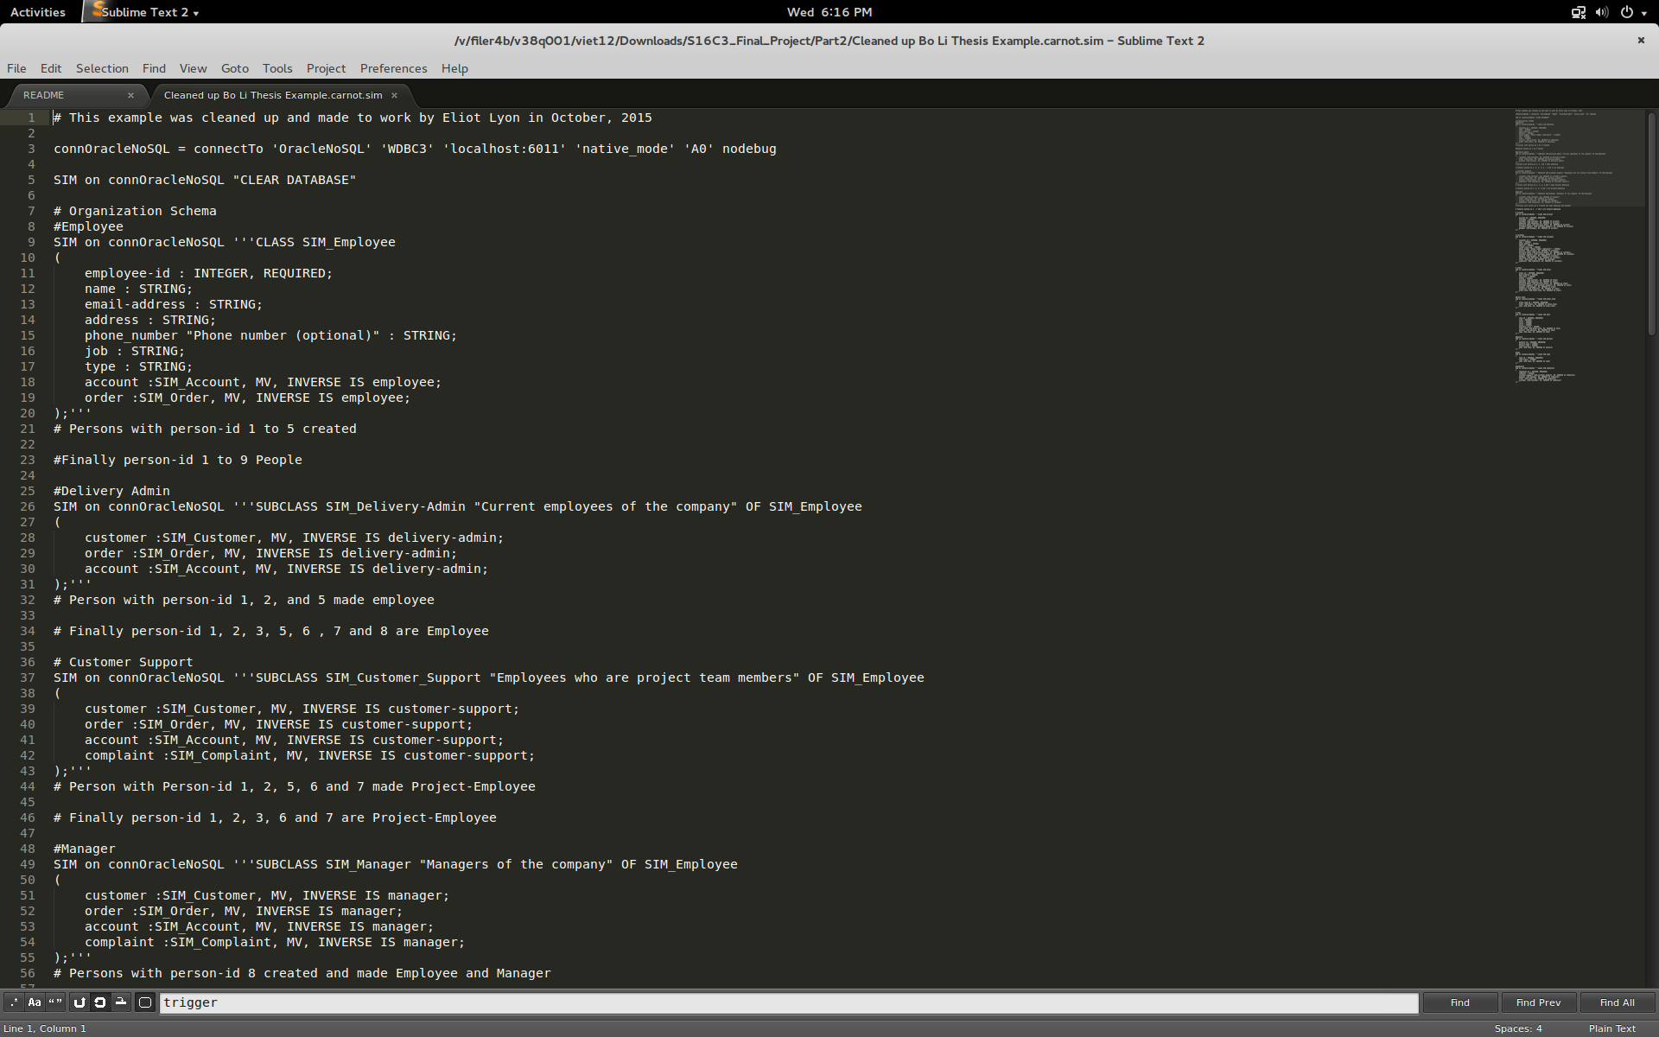
The SIM database we created
We completely re-wrote Bo Li’s Thesis to implement our database for our Part 2 Shoe app as shown below:
Notes:
Talk about the things you changed and how you changed the whole thing (Viet)

Slide 23
Differences Between Relational and SIM
SIM is object-oriented. You can create relationships in SIM just like Cypher.
You have to put in queries and parse the JSON sent back from the RESTful server into meaningful data.
Relationships in SIM are known as EVA’s which are Entity Valued Attributes because the values of the attributes are treated as entities
SIM supports subclasses and class hierarchies
You can build a SIM database straight from the conceptual model instead of having to convert from Conceptual->Logical->Relational

Slide 24
Thank You!

